Slide 1

Microsoft© SharePoint 2019 site owner
Trish Conner-Cato

Slide 2
Course overview
This course is designed for SharePoint site owners/managers new to SharePoint 2019. Introductory level SharePoint experience is recommended.
Skills gained:
Navigating a SharePoint 2019 Team site
Creating/editing web page content
Creating site columns and content types
Integrating Office applications with SharePoint 2019
Managing basic permissions

Slide 3
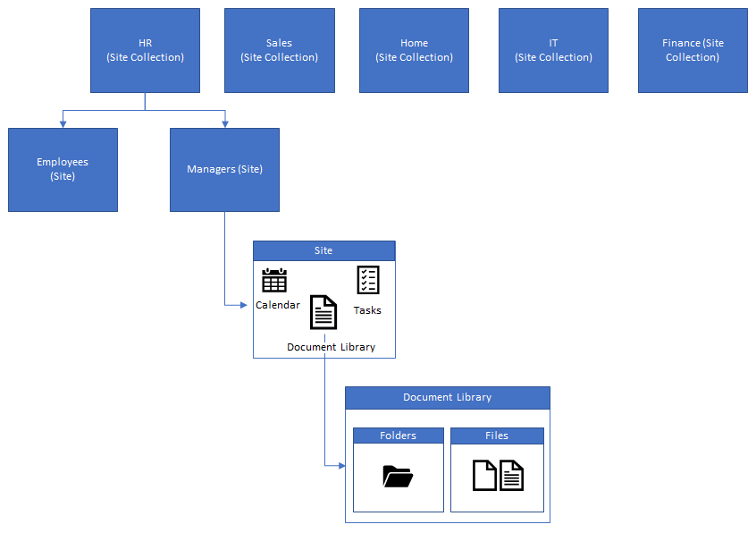
SharePoint 2019 Site architecture

Slide 4
Module 1: working with sites
All SharePoint content is accessed through a site. A SharePoint site serves as a container for lists and libraries and provides a starting point for basic administration. The site’s content (lists, libraries) and basic look and feel is initially determined by the Site Template used to create the site.
Site Templates
Creating a Team Site
Creating a Project Site
Lessons:
Files Used:
Excel: Goals/Employee Salaries
Word: Sales by Month
Creating a Community Site
Site Navigation
Managing Site Navigation

Slide 5
Module 1: basic terminology
List:
A SharePoint list is used to store information. Typically formatted with rows and columns. Attachments can be added to lists, based on list settings. Lists can be created from scratch, based on an Excel file, based on an existing list, or by using a list template.
Library:
A SharePoint library is used to store documents and files. There is typically a built-in asset library used to store rich-media files like images and videos.
Don’t sweat this terminology, the terms lists, and libraries are often used interchangeably.

Slide 6
Module 1: types of sites
Site Template | Use
Team site | A place to work together with a group of people.
Project site | A site for managing and collaborating on a project. Brings all status, communication and artifacts relevant to the project into one place
Community Site | Provides a forum experience in SharePoint. Communities are used to categorize and cultivate discussions among a broad group of people across organizations in a company.

Slide 7
Module 1: team sites
Site Type | Use
Modern | Works with Office 365 Groups Home Page has sections for News, Quick links, Site activity, and a Document Library Can use built-in or customized themes for branding
Classic | Does not work with Office 365 Groups Home Page has web parts for Announcements, Calendar, and Links Used site themes, alternate CSS, and master pages for branding

Slide 8
Module 2: page content
SharePoint offers a few ways to add content to the pages in a site. One method is using Wiki pages, and the other is using Web Parts.
Creating Wiki Library Pages
Lessons:
Editing the Team site Home Page
Creating Web Part Pages
Working with Web Parts
Adding Web Parts to Pages
Files Used: Excel – Expense Report Template
Png – Personal Link
Word – Website Links

Slide 9
Module 2: page content
Wiki Page Library
Wikiwiki means hurry, fast, or quick in Hawaiian. In SharePoint it is a method that allows creation and organization of a multi-page library.
Web Part Pages
Web parts are containers that hold different types of content. Web parts are like apps on your phone. Some, if not all, of the content on your site's homepage (or other pages) can be comprised of web parts.

Slide 10
Module 3: site columns and content types
Creating site columns and content types is a way of customizing SharePoint with reusable content. This content can be reused throughout the site, site collection, or even the whole farm.
Exploring the Site Column Gallery
Creating a Custom Site Column
Adding a Site Column to a List
Exploring the Site Content Types Gallery
Creating Content Types
Using Content Types
Lessons:
Files Used:
Word: Closing Sales Letter

Slide 11
Module 3: site columns and content types
A site column is a reusable column definition, or template, that you can assign to multiple lists across multiple SharePoint sites. One of the most basic elements that can be added to a SharePoint project, site columns not only ensure consistency of metadata across sites and lists but also reduces re-work.
A SharePoint content type pulls together an item and information about the item. The item might be one of many kinds of files, a document, an excel workbook, or even a status indicator for a progress report. It could also be a list or a folder. A content type associates this item with key metadata or other information such as a template or a retention policy.

Slide 12
Module 4: managing SharePoint site permissions
Permissions are assigned when a list is created. SharePoint defaults to assigning permissions at the root of the site collection to its child sites. Permission inheritance can be turned off at a site, list, library, or even at the item level of a list or library. Permissions can be assigned to individuals, SharePoint groups, or other groups such as Office 365 groups.
Reviewing SharePoint Groups
Lessons:
Assigning Permissions
Understanding Permission Levels
Understanding Permissions Inheritance

Slide 13
Module 4: permission Levels
Read– A user can view pages list items and download documents.
Restricted view – A user can view documents in the browser but are unable to download.
Contribute-A user can view, add, update, and delete list items and documents.
Edit– A user can add, edit and delete a list, and the user can also view, add, update and delete list items and documents.
Design– A user can view, add, update, delete, approve and customize.
Full control – A user having full control.

Slide 14
conclusion
Overview of Site Architecture
Created Sites:
Page Content:
Site Columns and Content Types
SharePoint Permissions
Team Site
Project Site
Community Site
Wiki Page Library
Web Parts
Branding
Two ways to reuse content across sites. Lends itself to standardization and efficiency
Can be assigned at the site, library/list, or item level.

